Slide 1

Supercomputing with R part 2
Agent-based model of all neighbourhoods in the Netherlands
Erik-Jan van Kesteren

Slide 2
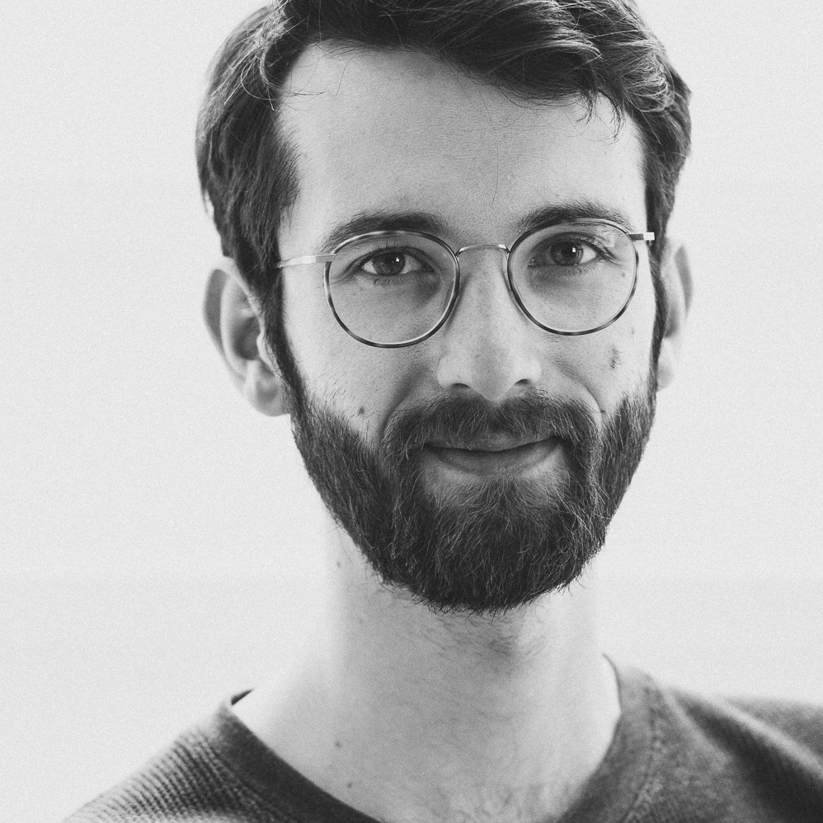
About me
Background
PhD in Statistics (UU) Structural Equation Models, high-dimensional data, regularization & penalization, algorithms & optimization
Assistant professor at Methodology & Statistics, UU Human Data Science group, teaching Data Science master courses
Team lead for the ODISSEI Social Data Science (SoDa) team Advancing data- & computation-intensive research in social science

Slide 3


Slide 4
About me
Relevant experience
Experience with parallel programming, supercomputing, large simulations statistics, social sciences, a bit of neuroscience (structural MRI), and a bit of bioinformatics (microarrays, epigenetics)
Native in R, capable in Python dabbled in C++, C#, web languages, Julia, and more
Many research consultations
Strongly advocating for open science Make everything available all the time!
Almost no experience with agent-based models!!!

Slide 5
About you
Write down in one short sentence why you are here / what you hope to learn

Slide 6
This afternoon
How to structure R projects for running analyses on a SURF supercomputer

Slide 7
This afternoon
Time | Title
13:00 | Lecture: computational limits in social science
13:45 | Hands-on: a parallel agent-based model in R
14:30 | Break
14:45 | Lecture: supercomputing with R
15:30 | Hands-on: submitting an R array job
16:00 | Break
16:15 | Lecture: combining & analysing the results
16:30 | Conclusion & Q&A

Slide 8
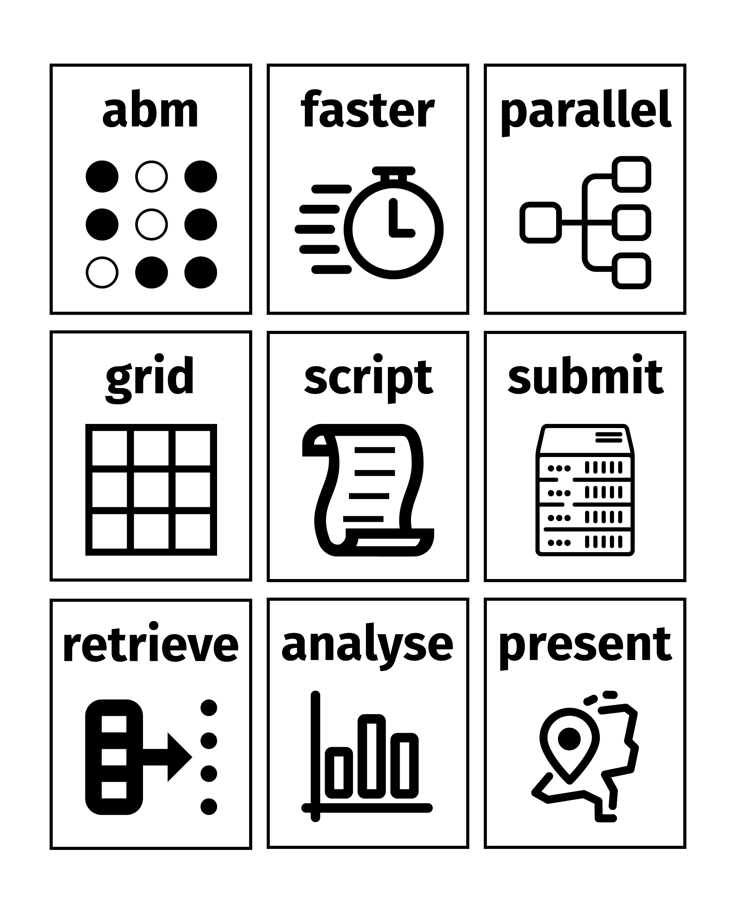
Hands-on 1
Hands-on 2
Lecture 3

Slide 9
Computational limits in social science

Slide 10
Experimental research in soc. sci.
Come up with research question
Design experiment
Run experiment
Analyze results (perform statistical test)
Make inferences about found effect

Slide 11
Observational research in soc. sci.
Come up with research question
Collect data
Create statistical model
Make inferences about model (pay attention to assumptions)

Slide 12
Computational research in soc. sci.?
Come up with research question
Create generative / computational model
Generate data from computational model
(compare computational model data with real data)
Make conclusions about computational model (pay attention to assumptions)

Slide 13
Psych trend: theory construction
A formal model captures the principles of the explanatory theory in a set of equations or rules (as implemented in a computer program or simulation).
The theorist can then examine whether the theory, as implemented in the formal model, does in fact generate the phenomena as a matter of course, either in a simulation study or through analytic derivations.
Borsboom et al. (2021), Theory Construction Methodology: A Practical Framework for Building Theories in Psychology doi.org/10.1177/1745691620969647

Slide 14
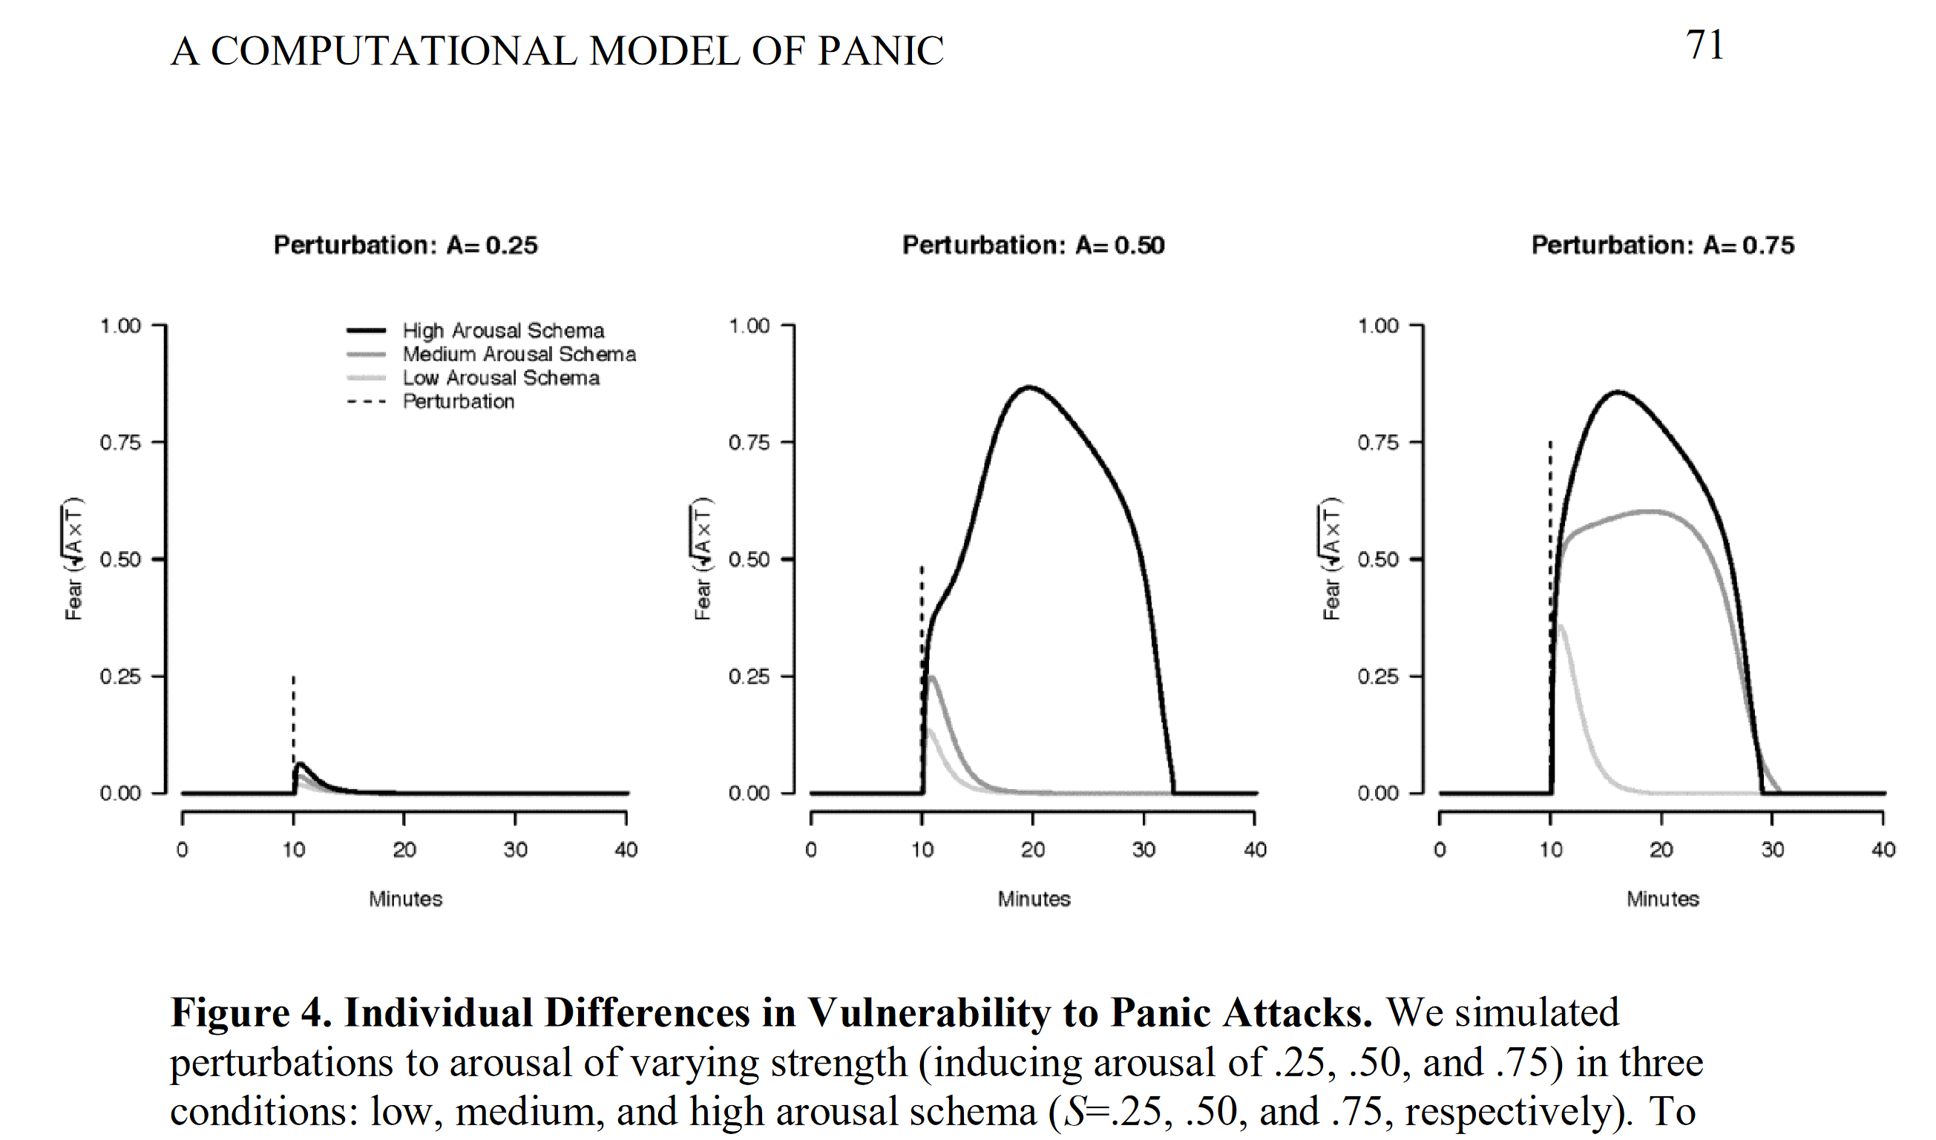
Robinaugh et al. (2019), A Computational Model of Panic Disorder 10.31234/osf.io/km37w

Slide 15
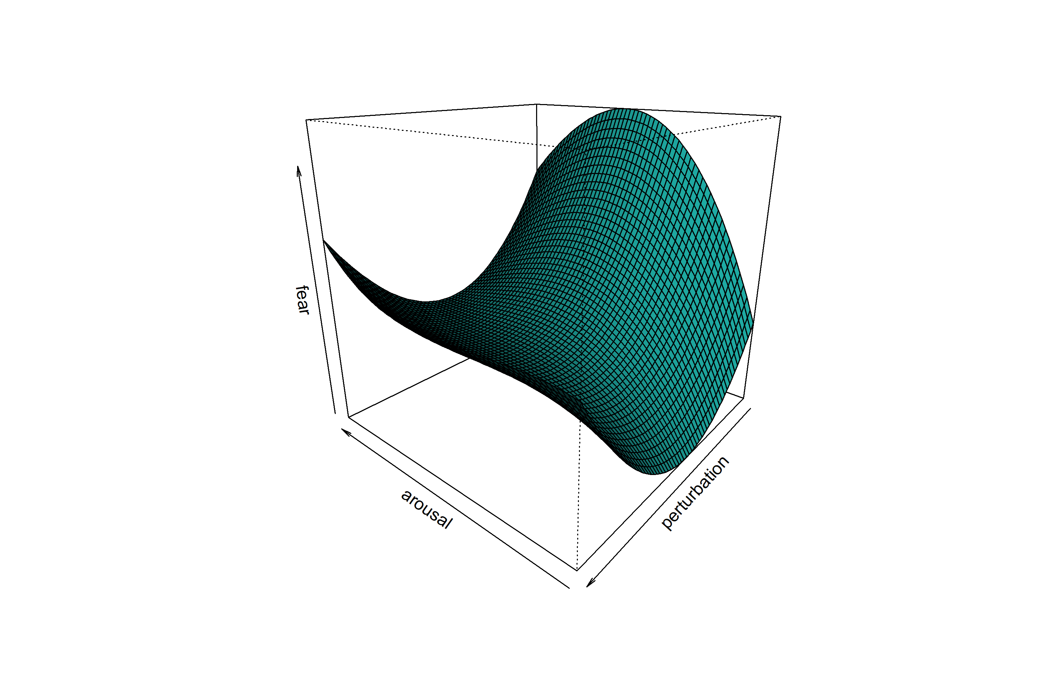
With more parameter settings?
(this is not real, just for illustration)

Slide 16
Agent-based models
Used in economics, sociology, ecology, finance, spatial planning, social psychology, and more
Create agents who interact in an environment
Each agent has rules based on theory
Simulating the system means applying these rules repeatedly
Then you can investigate the system

Slide 17

Agent-based models

Slide 18
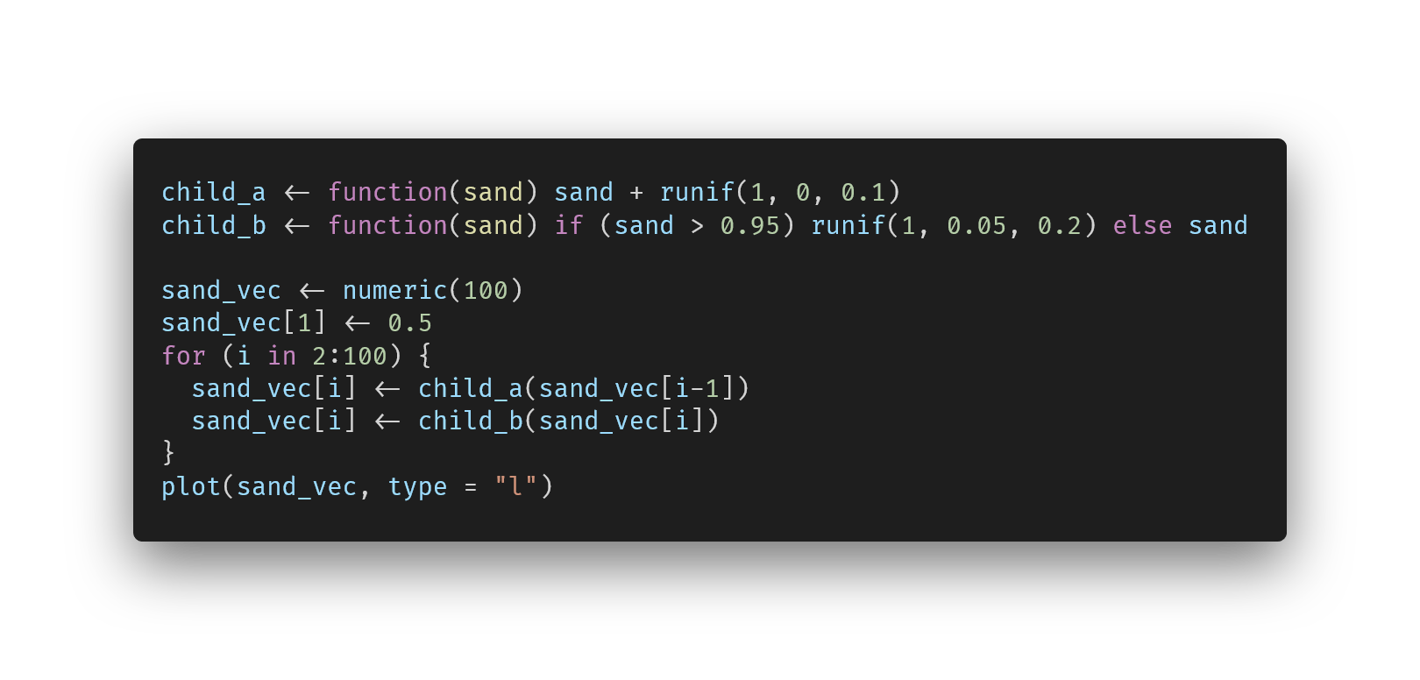
Agent-based models
Notes:
https://carbon.now.sh/?bg=rgba%28255%2C255%2C255%2C0%29&t=vscode&wt=none&l=auto&width=680&ds=true&dsyoff=13px&dsblur=33px&wc=false&wa=true&pv=79px&ph=76px&ln=false&fl=1&fm=Fira+Code&fs=14px&lh=133%25&si=false&es=2x&wm=false&code=child_a%2520%253C-%2520function%28sand%29%2520sand%2520%252B%2520runif%281%252C%25200%252C%25200.1%29%250Achild_b%2520%253C-%2520function%28sand%29%2520if%2520%28sand%2520%253E%25200.95%29%2520runif%281%252C%25200.05%252C%25200.2%29%2520else%2520sand%250A%250Asand_vec%2520%253C-%2520numeric%28100%29%250Asand_vec%255B1%255D%2520%253C-%25200.5%250Afor%2520%28i%2520in%25202%253A100%29%2520%257B%250A%2520%2520sand_vec%255Bi%255D%2520%253C-%2520child_a%28sand_vec%255Bi-1%255D%29%250A%2520%2520sand_vec%255Bi%255D%2520%253C-%2520child_b%28sand_vec%255Bi%255D%29%250A%257D%250Aplot%28sand_vec%252C%2520type%2520%253D%2520%2522l%2522%29

Slide 19
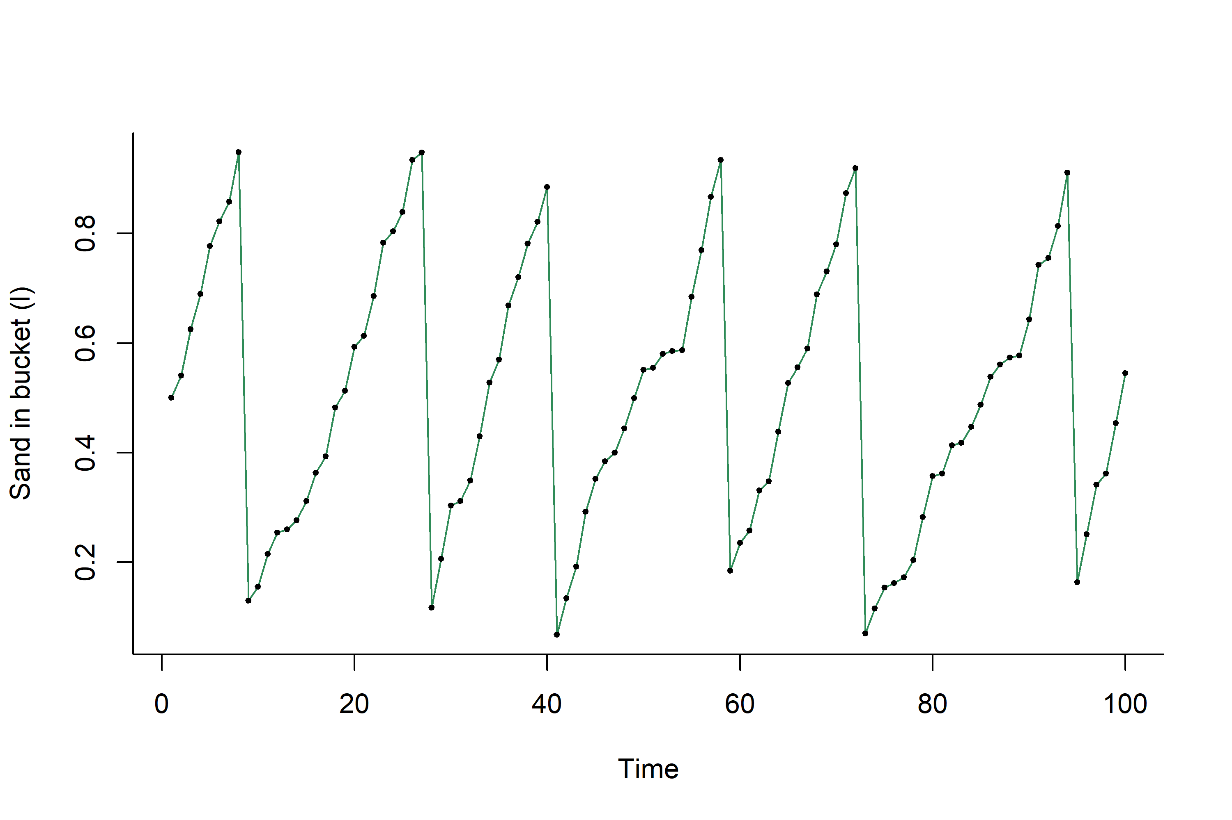
Agent-based models
Notes:
Micro behaviour leads to macro phenomena. Might be interested in distribution of speed of bucket filling, or in distribution of maximum of bucket, or in time to half-full, or ….

Slide 20
Interim conclusion
Computational methods used by social scientists to formalize & investigate theories
Simulation from computational models to inspect phenomena following from model
Do this for different parameter settings
(2) and (3) may take a long time -> computational limits reached!

Slide 21
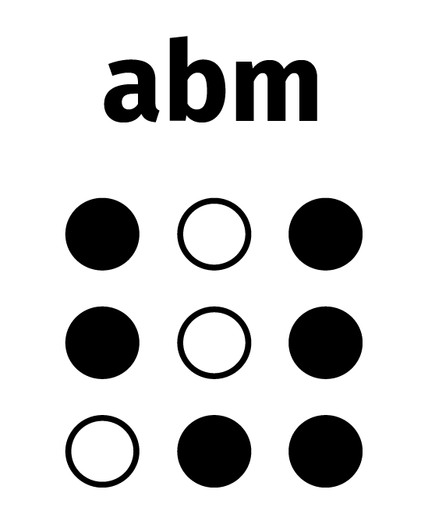

Slide 22
Schelling’s model of segregation

Slide 23
Schelling segregation model
Famous example of ABM in social behaviour
What are the causes of de facto segregation in society?
Theoretical / formal model of population dynamics
Implemented as an agent-based model
Conclusions drawn based on phenomena resulting from this model

Slide 24
Schelling segregation model
Environment: two-dimensional grid
Agents belong to one of two groups
Agents want to live close to others like themselves
Agents have preference (B_{a}) for the proportion of neighbours like them (B)
If B < B_{a}, then move to random free location on grid
Else stay

Slide 25
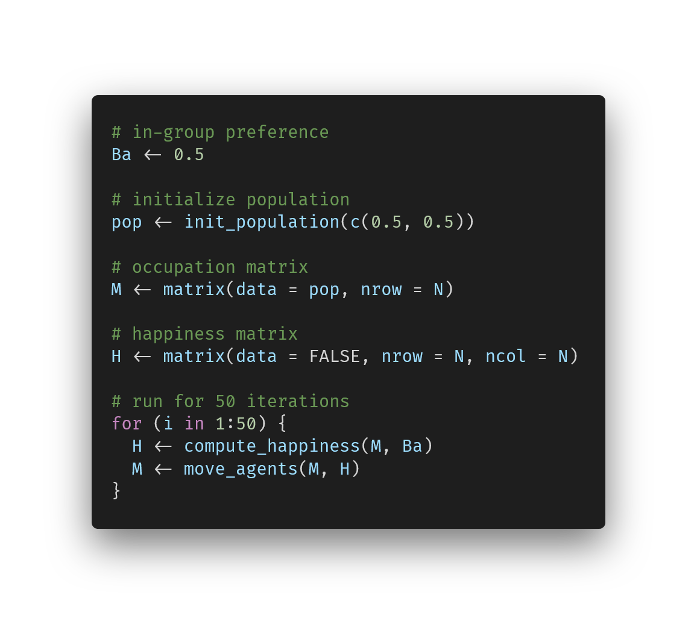
Schelling segregation model
Notes:
https://carbon.now.sh/?bg=rgba%28255%2C255%2C255%2C0%29&t=vscode&wt=none&l=r&width=680&ds=true&dsyoff=13px&dsblur=33px&wc=false&wa=true&pv=79px&ph=76px&ln=false&fl=1&fm=Fira+Code&fs=14px&lh=133%25&si=false&es=2x&wm=false&code=%2523%2520in-group%2520preference%250ABa%2520%253C-%25200.5%250A%250A%2523%2520initialize%2520population%250Apop%2520%253C-%2520init_population%28c%280.5%252C%25200.5%29%29%250A%250A%2523%2520occupation%2520matrix%250AM%2520%253C-%2520matrix%28data%2520%253D%2520pop%252C%2520nrow%2520%253D%2520N%29%250A%250A%2523%2520happiness%2520matrix%250AH%2520%253C-%2520matrix%28data%2520%253D%2520FALSE%252C%2520nrow%2520%253D%2520N%252C%2520ncol%2520%253D%2520N%29%250A%250A%2523%2520run%2520for%252050%2520iterations%250Afor%2520%28i%2520in%25201%253A50%29%2520%257B%250A%2520%2520H%2520%253C-%2520compute_happiness%28M%252C%2520Ba%29%250A%2520%2520M%2520%253C-%2520move_agents%28M%252C%2520H%29%250A%257D

Slide 26

Schelling segregation model
Notes:
init

Slide 27

Schelling segregation model
Notes:
3

Slide 28

Schelling segregation model
Notes:
9

Slide 29

Schelling segregation model
Notes:
20

Slide 30

Schelling segregation model
Notes:
50 iters

Slide 31
Schelling segregation model
Micro behaviour: happy or unhappy with current location -> move or stay
Macro phenomenon: how does the distribution of agents over the grid look?

Slide 32
Schelling segregation model
Schelling’s finding: for groups of equal size with B_{a} ≳ 0.33, the system is likely to end in a segregated state
Below that, the system will stay in a mixed / random state
Conclusion
Even if there is only a mild in-group preference, the world might still end up very segregated!
(keep assumptions in mind ☺)

Slide 33
Schelling segregation model
Note: randomness in initialization & in movement to different locations
At which B_{a} will the system segregate?
Need to run this model many times for different B_{a} and compute expectation (average over the iterations)
Monte carlo simulation

Slide 34
Schelling segregation model
Some more parameters you may want to vary:
Number of distinct populations
Relative population sizes
Number of free spots in the grid
Neighbour preference
Radius for looking at neighbours
Other extensions…
Notes:
Other extensions such as how far can people move, depending on group membership, much much more.

Slide 35
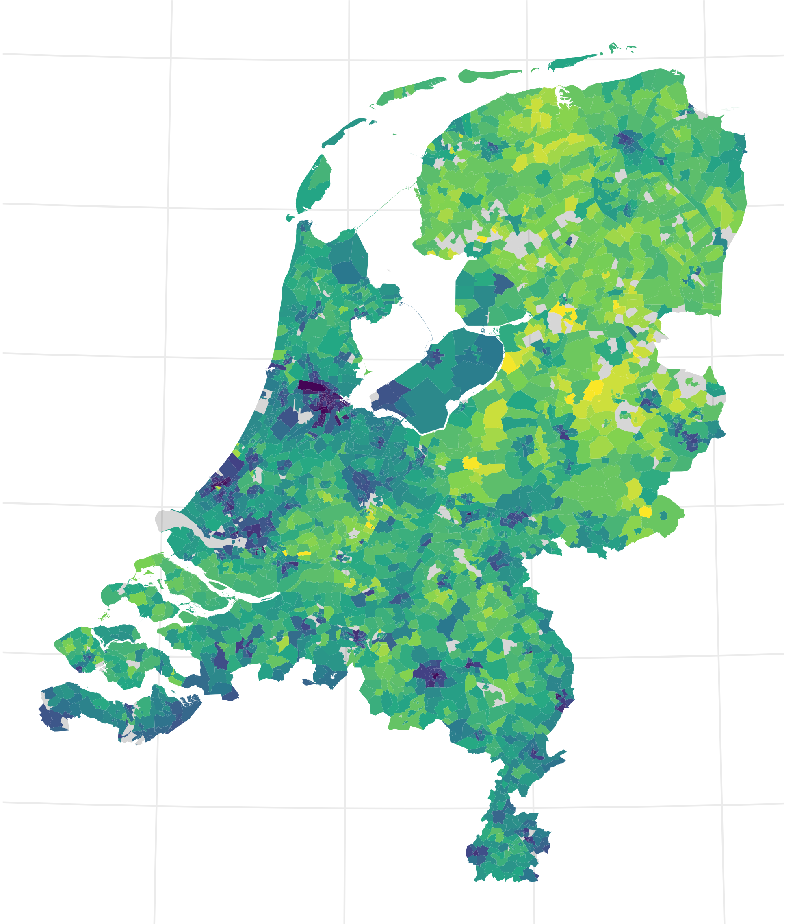

Slide 36
This will take a long time

Slide 37
Speeding up the ABM

Slide 38

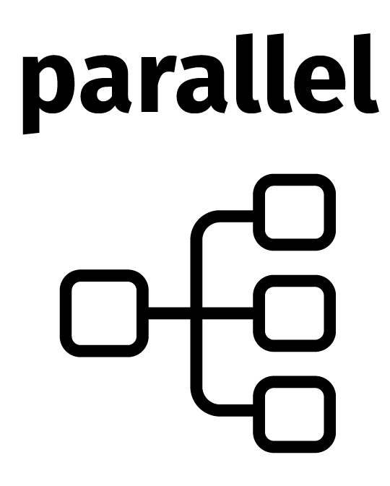
Two options
Write faster, optimized code
Run multiple ABMs at the same time
Notes:
Other extensions such as how far can people move, depending on group membership, much much more.

Slide 39

Two options
Write faster, optimized code
Run multiple ABMs at the same time
Notes:
Other extensions such as how far can people move, depending on group membership, much much more.

Slide 41
Speeding up slow code
There isn’t one solution for all types of code
Speeding up slow code takes time
Investigate smarter algorithms for your problem!
If you are rewriting your R code, use vectorized & matrix operations where possible (faster than loops!)
Use benchmarking to check the speed & memory usage of your functions (I like bench::mark())

Slide 42
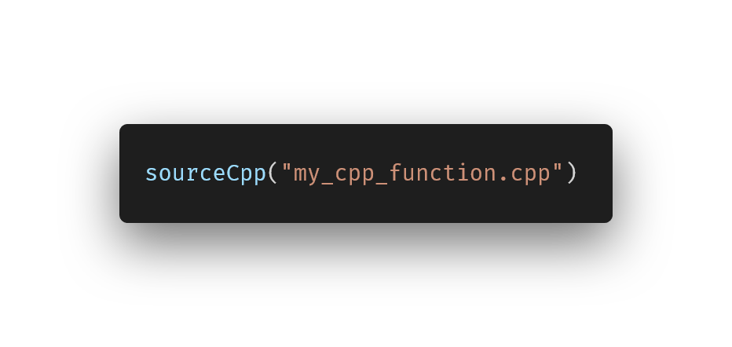
Speeding up slow code
Another step: rewrite in C++
Depending on problem, this may yield great speedup
In R: Rcpp package helps with this
Notes:
https://carbon.now.sh/?bg=rgba%28255%2C255%2C255%2C0%29&t=vscode&wt=none&l=r&width=680&ds=true&dsyoff=13px&dsblur=33px&wc=false&wa=true&pv=79px&ph=76px&ln=false&fl=1&fm=Fira+Code&fs=14px&lh=133%25&si=false&es=2x&wm=false&code=sourceCpp%28%2522my_cpp_function.cpp%2522%29

Slide 43
An example of Rcpp speedup is in the hands-on later

Slide 44
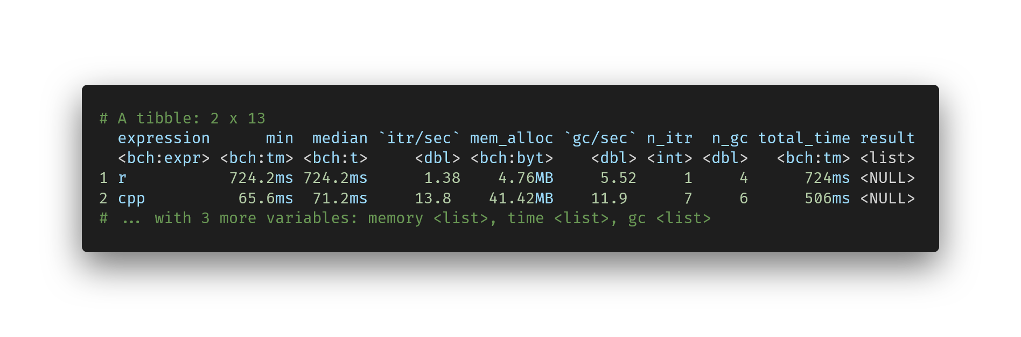
Notes:
https://carbon.now.sh/?bg=rgba%28255%2C255%2C255%2C0%29&t=vscode&wt=none&l=r&width=680&ds=true&dsyoff=13px&dsblur=33px&wc=false&wa=true&pv=79px&ph=76px&ln=false&fl=1&fm=Fira+Code&fs=14px&lh=133%25&si=false&es=2x&wm=false&code=%2523%2520A%2520tibble%253A%25202%2520x%252013%250A%2520%2520expression%2520%2520%2520%2520%2520%2520min%2520%2520median%2520%2560itr%252Fsec%2560%2520mem_alloc%2520%2560gc%252Fsec%2560%2520n_itr%2520%2520n_gc%2520total_time%2520result%250A%2520%2520%253Cbch%253Aexpr%253E%2520%253Cbch%253Atm%253E%2520%253Cbch%253At%253E%2520%2520%2520%2520%2520%253Cdbl%253E%2520%253Cbch%253Abyt%253E%2520%2520%2520%2520%253Cdbl%253E%2520%253Cint%253E%2520%253Cdbl%253E%2520%2520%2520%253Cbch%253Atm%253E%2520%253Clist%253E%250A1%2520r%2520%2520%2520%2520%2520%2520%2520%2520%2520%2520%2520724.2ms%2520724.2ms%2520%2520%2520%2520%2520%25201.38%2520%2520%2520%25204.76MB%2520%2520%2520%2520%25205.52%2520%2520%2520%2520%25201%2520%2520%2520%2520%25204%2520%2520%2520%2520%2520%2520724ms%2520%253CNULL%253E%250A2%2520cpp%2520%2520%2520%2520%2520%2520%2520%2520%2520%252065.6ms%2520%252071.2ms%2520%2520%2520%2520%252013.8%2520%2520%2520%252041.42MB%2520%2520%2520%252011.9%2520%2520%2520%2520%2520%25207%2520%2520%2520%2520%25206%2520%2520%2520%2520%2520%2520506ms%2520%253CNULL%253E%250A%2523%2520...%2520with%25203%2520more%2520variables%253A%2520memory%2520%253Clist%253E%252C%2520time%2520%253Clist%253E%252C%2520gc%2520%253Clist%253E

Slide 46
Parallel programming
Many problems are of the “embarrassingly parallel” type Little to no effort required to separate problem into number of parallel tasks
ABM itself is not embarrassingly parallel: time step 3 requires results from time step 2!
Running the whole ABM several times to average over uncertainty is embarrassingly parallel

Slide 47
Parallel programming
Computers nowadays can do more than one task at a time: threads
Often: 4 or 8 threads
Bigger computers have 12, 16 or 32 threads
Depending on computer, potential speedup of 32 times! (remember that our Rcpp effort gave ~10 times)
Parallel programming is built into R (package parallel)
Notes:
https://carbon.now.sh/?bg=rgba%28255%2C255%2C255%2C0%29&t=vscode&wt=none&l=r&width=680&ds=true&dsyoff=13px&dsblur=33px&wc=false&wa=true&pv=79px&ph=76px&ln=false&fl=1&fm=Fira+Code&fs=14px&lh=133%25&si=false&es=2x&wm=false&code=library%28parallel%29%250A%250A%2523%2520create%2520a%2520function%2520to%2520run%2520in%2520parallel%250Amy_func%2520%253C-%2520function%28i%29%2520sprintf%28%2522this%2520is%2520iteration%2520%2525i%2522%252C%2520i%29%250A%250A%2523%2520instantiate%25208%2520workers%250Aclus%2520%253C-%2520makeCluster%288%29%250A%250A%2523%2520run%2520the%2520function%2520for%2520iteration%25201%253A100%250AparSapply%28clus%252C%25201%253A100%252C%2520my_func%29%250A%250A%2523%2520stop%2520the%2520workers%2520%28we%27re%2520done%2520with%2520them%2520now%29%250AstopCluster%28clus%29

Slide 48
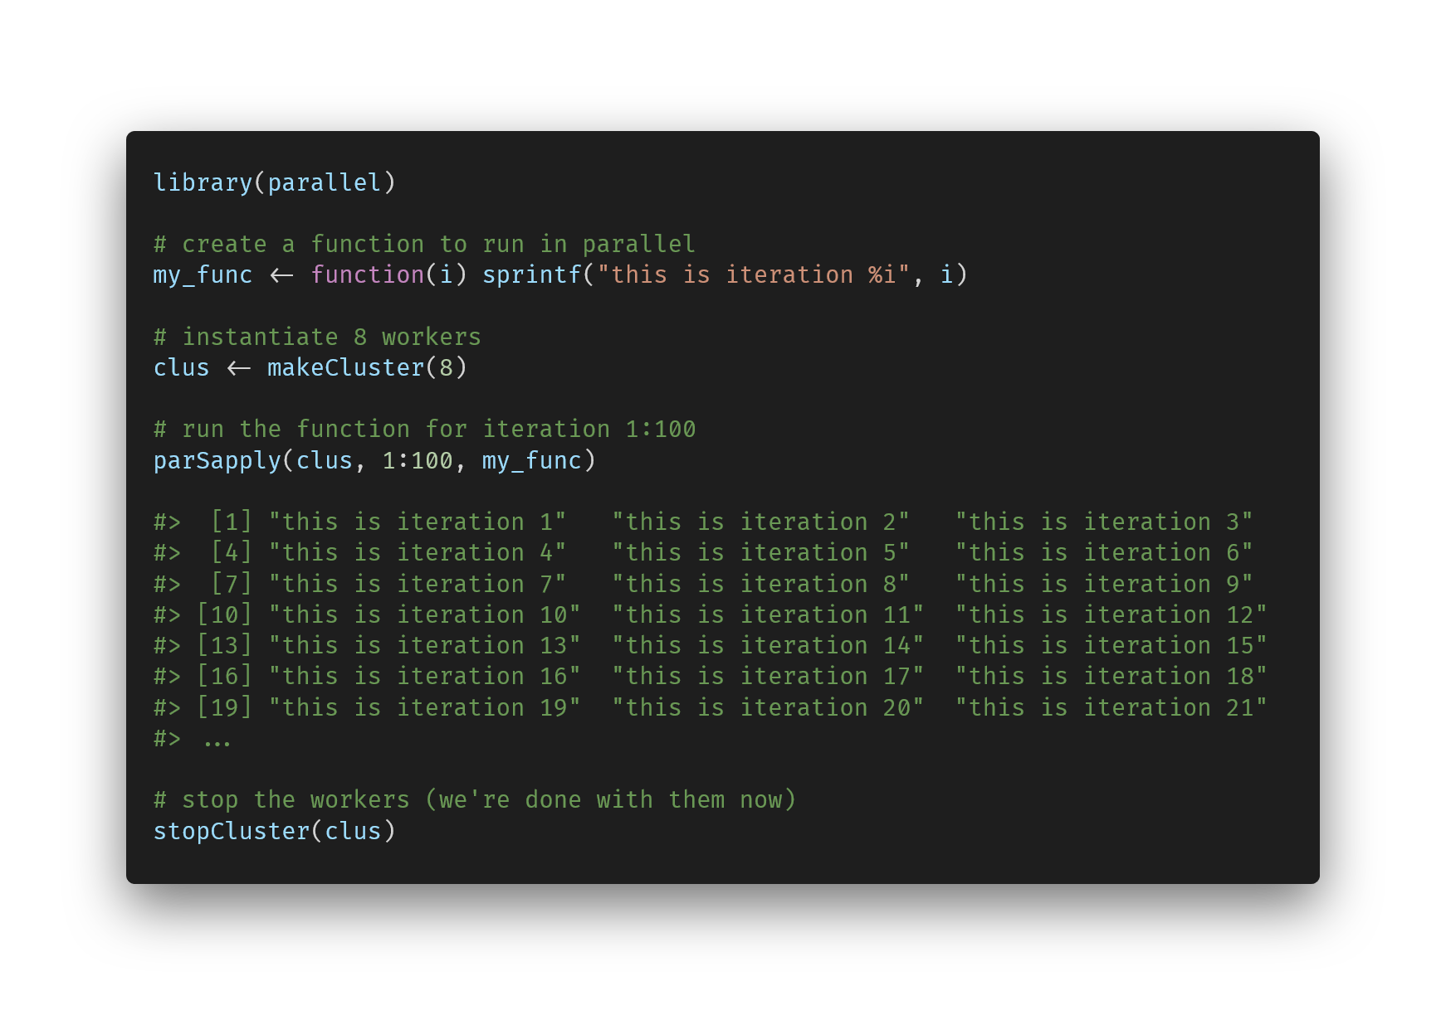
Notes:
https://carbon.now.sh/?bg=rgba%28255%2C255%2C255%2C0%29&t=vscode&wt=none&l=r&width=680&ds=true&dsyoff=13px&dsblur=33px&wc=false&wa=true&pv=79px&ph=76px&ln=false&fl=1&fm=Fira+Code&fs=14px&lh=133%25&si=false&es=2x&wm=false&code=library%28parallel%29%250A%250A%2523%2520create%2520a%2520function%2520to%2520run%2520in%2520parallel%250Amy_func%2520%253C-%2520function%28i%29%2520sprintf%28%2522this%2520is%2520iteration%2520%2525i%2522%252C%2520i%29%250A%250A%2523%2520instantiate%25208%2520workers%250Aclus%2520%253C-%2520makeCluster%288%29%250A%250A%2523%2520run%2520the%2520function%2520for%2520iteration%25201%253A100%250AparSapply%28clus%252C%25201%253A100%252C%2520my_func%29%250A%250A%2523%253E%2520%2520%255B1%255D%2520%2522this%2520is%2520iteration%25201%2522%2520%2520%2520%2522this%2520is%2520iteration%25202%2522%2520%2520%2520%2522this%2520is%2520iteration%25203%2522%2520%2520%250A%2523%253E%2520%2520%255B4%255D%2520%2522this%2520is%2520iteration%25204%2522%2520%2520%2520%2522this%2520is%2520iteration%25205%2522%2520%2520%2520%2522this%2520is%2520iteration%25206%2522%2520%2520%250A%2523%253E%2520%2520%255B7%255D%2520%2522this%2520is%2520iteration%25207%2522%2520%2520%2520%2522this%2520is%2520iteration%25208%2522%2520%2520%2520%2522this%2520is%2520iteration%25209%2522%2520%2520%250A%2523%253E%2520%255B10%255D%2520%2522this%2520is%2520iteration%252010%2522%2520%2520%2522this%2520is%2520iteration%252011%2522%2520%2520%2522this%2520is%2520iteration%252012%2522%2520%250A%2523%253E%2520%255B13%255D%2520%2522this%2520is%2520iteration%252013%2522%2520%2520%2522this%2520is%2520iteration%252014%2522%2520%2520%2522this%2520is%2520iteration%252015%2522%2520%250A%2523%253E%2520%255B16%255D%2520%2522this%2520is%2520iteration%252016%2522%2520%2520%2522this%2520is%2520iteration%252017%2522%2520%2520%2522this%2520is%2520iteration%252018%2522%2520%250A%2523%253E%2520%255B19%255D%2520%2522this%2520is%2520iteration%252019%2522%2520%2520%2522this%2520is%2520iteration%252020%2522%2520%2520%2522this%2520is%2520iteration%252021%2522%2520%250A%2523%253E%2520...%250A%250A%2523%2520stop%2520the%2520workers%2520%28we%27re%2520done%2520with%2520them%2520now%29%250AstopCluster%28clus%29

Slide 49
An example of parallel programming is in the hands-on later

Slide 50
Interim conclusion
Today we are working with the Schelling agent-based model
Running the abm with different settings takes a long time
We can program the abm itself more efficiently
We can perform the abm in parallel
Let’s try it out!

Slide 51
Hands-on session 1

Slide 52
Questions?

Slide 53
Default light slide
Default subheading
This is the body of the text
Default subheading
Note that the text is not black, but “black, text 1, lighter 25%”
Default subheading
This makes things easier on the eyes
Default subheading
This is the body of the text

Slide 54
Default dark slide
Default subheading
The dark slide brings some variation
Default subheading
It can highlight important aspects of the presentation.
Default subheading
This is the body of the text
Default subheading
This is the body of the text

Slide 55
Is this an impact slide?

Slide 56
Here is an impactful slide with a sentence on it.
Here is a topic related to the aforementioned question.

